Slide 1
SPECIAL ID Creation Application
AD Team Automation
About this deck
This is all about features, Value-added, Benefits of using Special ID Creation Application for creating SID, GID, FTP ID, KIOSK ID.

Slide 2
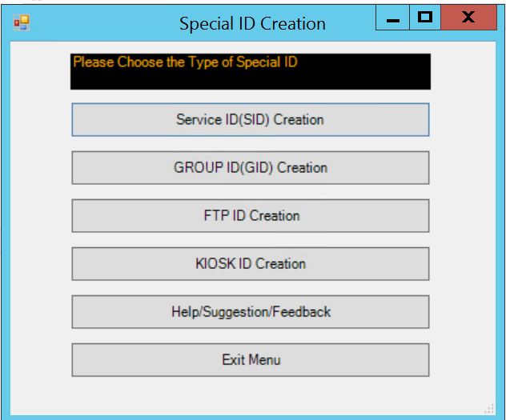
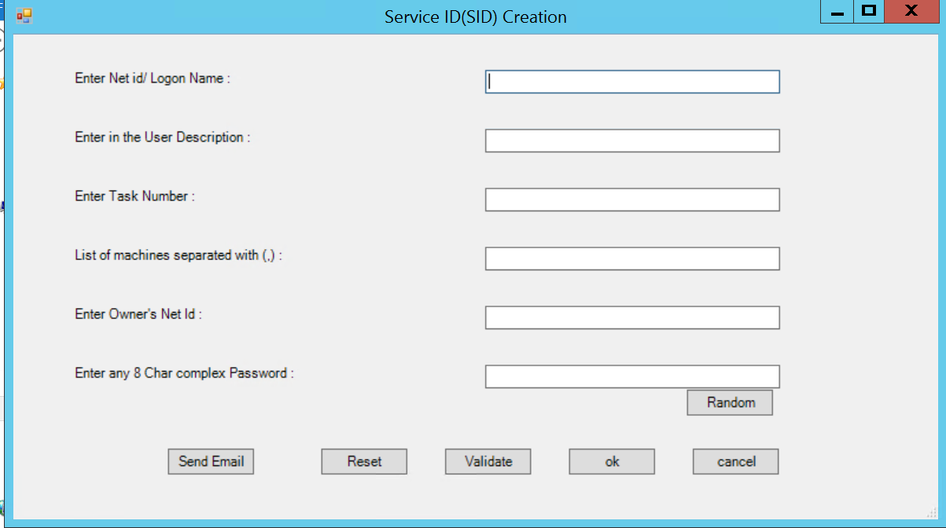

Menus
Main Menu
ID Creation Menu

Slide 3
Main Menu Features
Simple Choose option Menu providing smooth selection of Type of Special Id which is required with just a click of the desired Button. One can select anyone of the shown 4 special ids and navigate to respective ID creation Menu.
One can also opt for Help in worst scenarios which will be very rare. User can share their Suggestion/Feedback or any improvement by clicking Help/Suggestion/Feedback button and we will reach out with best possible solution.

Slide 4
ID Creation Menu
Features:
Enter Net id/Logon Name: Provide the new Id to be created
Enter the User Description: Provide Desired Description of ID
Enter Task Number: Provide the Request Number details
List of Machines Separated with (,) : Provide the PC/ Machine names for which log to access is needed for the Special Id.
Enter Owner’s Net id: Details will update the Manager of the account.
Enter any 8 Char Complex Password: Provide any 8 char complex password.
“If one wants the password to get auto-generated then one can click on Random button and voila!! It will suggest one the best and strongest password.”
Validate Button: It will validate all the information i.e. let you know if the New id enter is already existing or not, Check if Owner net id is valid or not, Check if Password entered meet the password criteria or not.
Ok Button/ Send Email Button: Ok Button will create the Requested Special Id and Send Email Button will send Email containing Password with the Owner of the Special Id.
Reset Button: It will reset all the fields so that one can re-use for creating multiple Special ids without closing and re-opening the app.
1
2
3
4

Slide 5
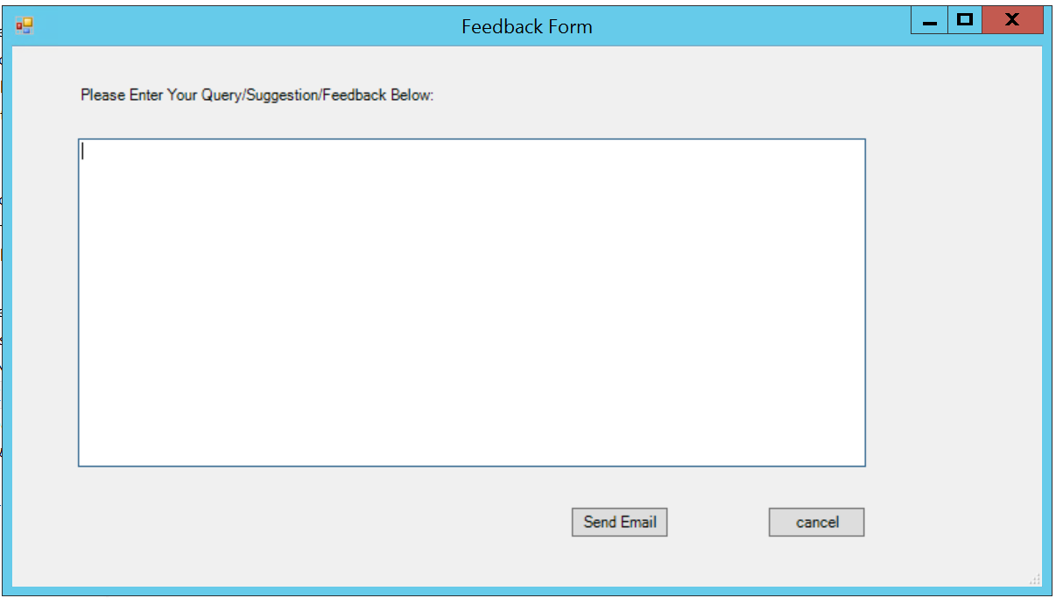
Help/Suggestions/Feedback
This Menu Allows users to share their thoughts, If they got stuck somewhere then they can always take necessary help, If they have any ideas on improving this application then also they can provide the details in the same.
1
The Giant Textbox allows users to provide data in as much details as they need.
2
All you need to do is click Send Email Button and your responses will reach out to us. We will certainly check that and reach out to users with the best that we can offer.

Slide 6

Advantages of using Special ID Creation app (VALUE_ADDED)
1
No need to worry about the authenticity of provided details as with just clicking “VALIDATE” Button one can validate the entered details and be assured about below:
If the id which is going to be created is already existing or not
If the net id of the owner is valid or not.
If the Password entered meet the standard password criteria or not.
2
Saves almost around 20 minutes of time in creating each Special Id : Easy textbox entry with no hustle to navigate to ADUC, Find and Select appropriate OU, Fill out each and every fields, Type strong passwords, Add necessary groups with respect to the type of Special ID, Select if user should change password/ password never expires, Update owner/ description /manager and many other options.
IT does all the above Job with just a click of button.
3
No need to draft email and copy paste the password and owner details. The app’s “Send Email” Button will take care of sending email containing password information with the owner of the Special ID created.
4
No need of closing and re-opening the app to create another Special Id again and again. One can clear all the textboxes with just a click of “RESET” Button and re-use the menu to create another Special Id.
5
The app also create a “LOG” of all the activities performed so that we can no longer worry about auditing.

Slide 7

Thank You !!

